Slide 1
Raising your organization’s security posture with Microsoft’s cloud
Microsoft Security at
Pre-day Security Workshop/Lab
With breaches and security incidents commonplace, many IT professionals have – both consciously and unconsciously – gained responsibilities in the security space. How do you raise your organization’s security posture when security isn’t your primary responsibility? In this interactive workshop, we’re going to show you how to optimize your organization’s security posture in a holistic manner using Microsoft Entra, Microsoft Purview, Microsoft Defender for Cloud, and Microsoft Sentinel.
November 14th, 2023
1pm to 6pm PST
Hands-on:
Entra ID, ID Governance, and ID Workload
Purview Compliance, Labeling, Policies, Insider Risk
Microsoft Defender for Cloud Workload Security, Compliance, and Security Alert mitigation
Microsoft Sentinel connecting data and analyzing logs, investigating and hunting threats, TI, automation, and reporting.

Slide 2
Today’s Schedule
Topic | Speakers | Length | Time (approx)
Intro | Rod Trent
Entra |  |  | 1 PM
Discussion | Janice Ricketts, David Hoerster | 30-40 minutes
Lab |  | 45 minutes
Break
Purview |  |  | 2:30 PM
Discussion | Sarah Young, Rod Trent, Edward Walton | 30-40 minutes
Lab |  | 45 minutes
Break
Defender for Cloud |  |  | 4:00 PM
Discussion | Alex Steele, Fernanda Vela | 20 minutes
Lab |  | 25 minutes
Break
Microsoft Sentinel |  |  | 5:00 PM
Discussion | Beth Bischoff, Kerinne Browne | 30-40 minutes
Lab |  | 40 minutes
Close
Microsoft Security at
November 14th, 2023
1pm to 6pm PST

Slide 3
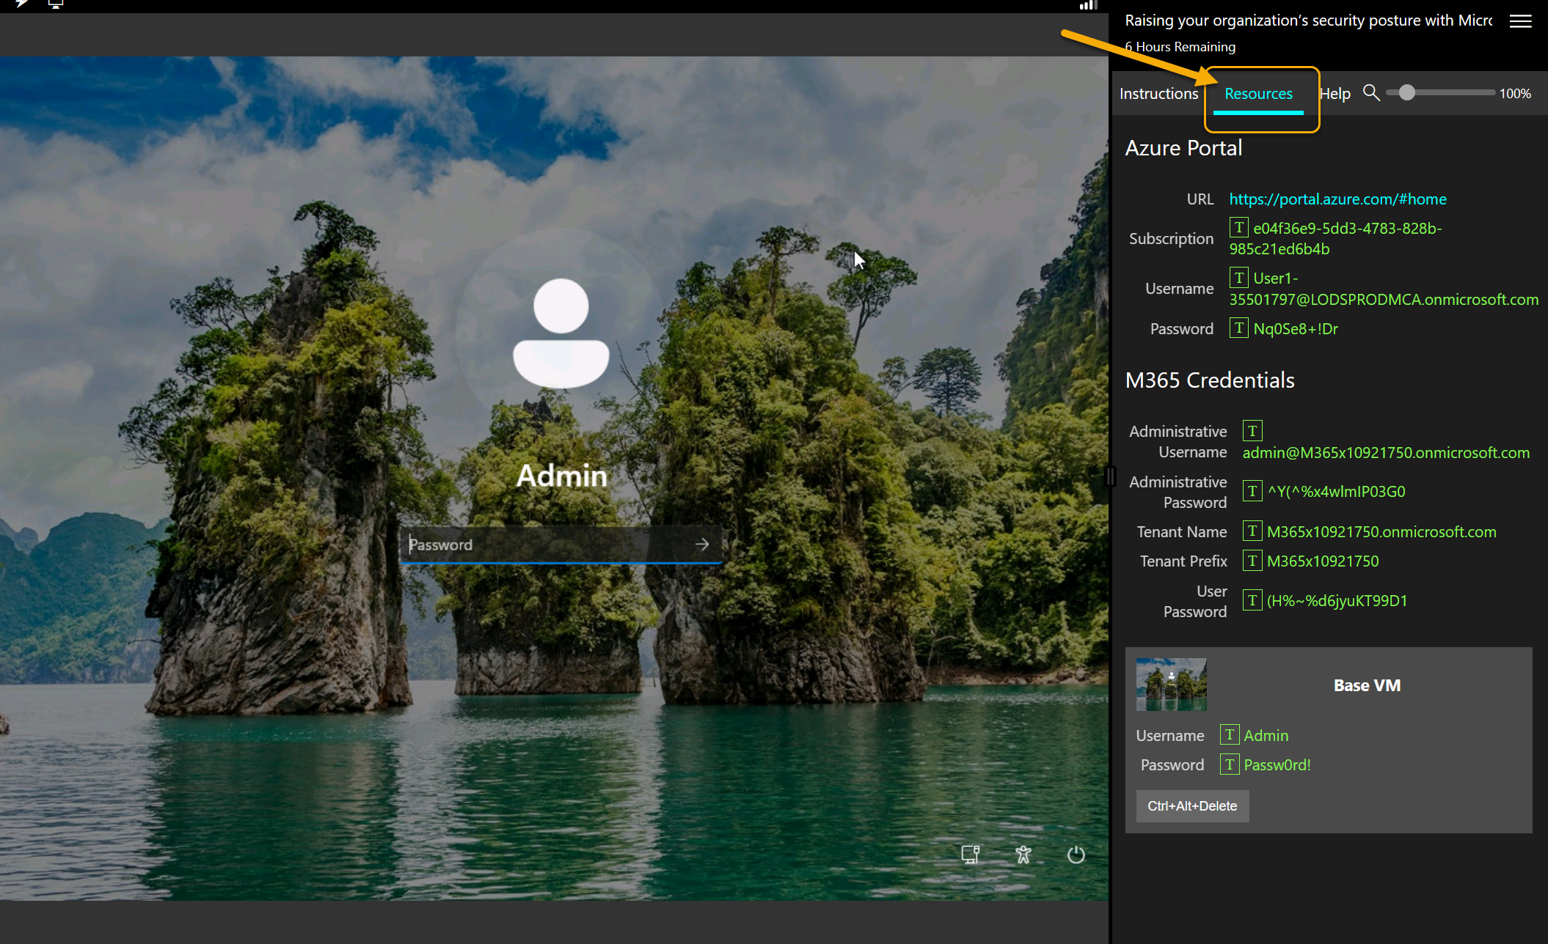

Slide 4
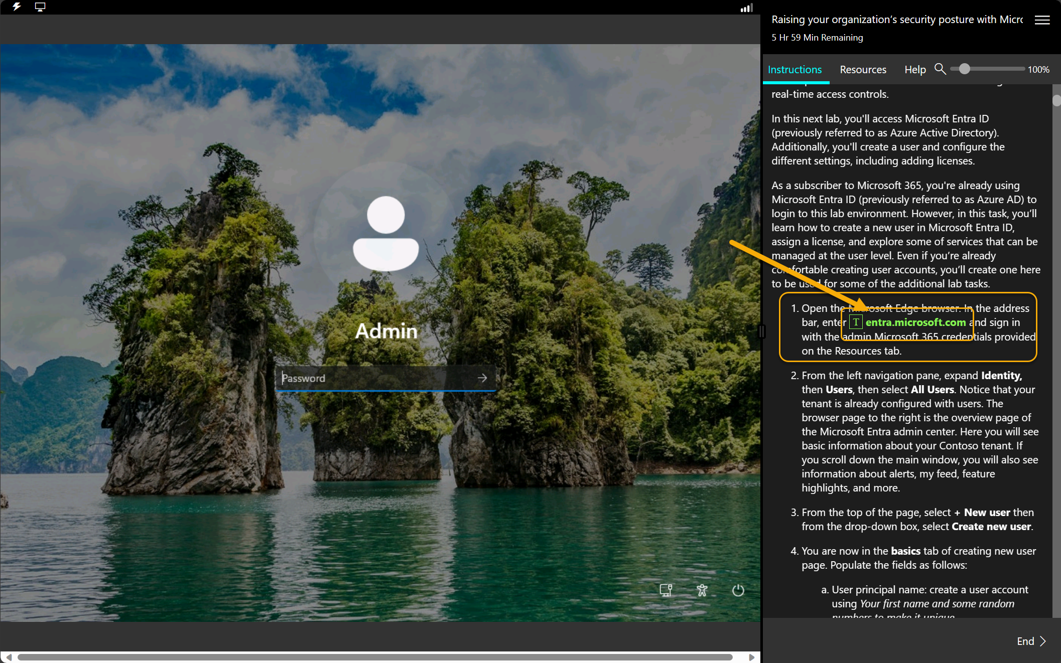

Slide 5
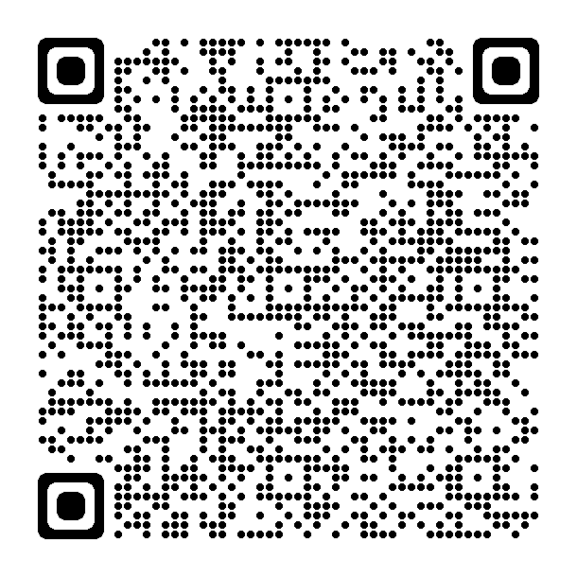
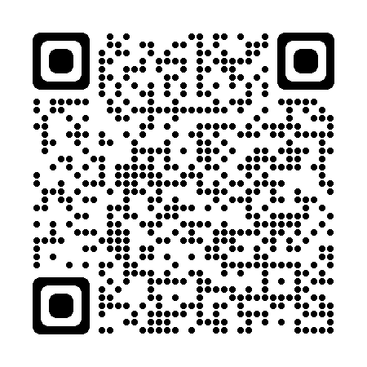
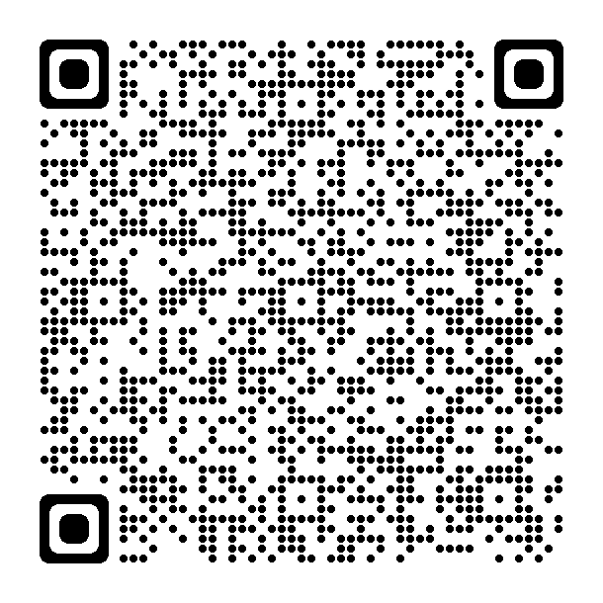
Goals:
Microsoft Security at
Get exposure
Get expert tips
Take it deeper – more labs this week
Take an exam
Applied Skills
November 14th, 2023
1pm to 6pm PST
More labs
Certs
Applied Skills

Slide 6
Today’s Schedule
Topic | Speakers | Length | Time (approx)
Intro | Rod Trent
Entra |  |  | 1 PM
Discussion | Janice Ricketts, David Hoerster | 30-40 minutes
Lab |  | 45 minutes
Break
Purview |  |  | 2:30 PM
Discussion | Sarah Young, Rod Trent, Edward Walton | 30-40 minutes
Lab |  | 45 minutes
Break
Defender for Cloud |  |  | 4:00 PM
Discussion | Alex Steele, Fernanda Vela | 20 minutes
Lab |  | 25 minutes
Break
Microsoft Sentinel |  |  | 5:00 PM
Discussion | Beth Bischoff, Kerinne Browne | 30-40 minutes
Lab |  | 40 minutes
Close
Microsoft Security at
November 14th, 2023
1pm to 6pm PST

